Slide 1
Writing R Markdown Reports and Using Custom Moffitt Templates and Packages
William “Jimmy” Fulp
12/14/2018

Slide 2
Overview
R Markdown is a file format for making dynamic documents with R. An R Markdown document is written in markdown (an easy-to-write plain text format) and contains chunks of embedded R code.
The purpose of this workshop is to introduce R Markdown reports, as well as the custom Moffitt Templates and Functions I’ve written specifically to easily make fancy statistical reports.
Short presentation, followed by creating our own reports

Slide 3
Outline
Data Analysis Process
R Markdown
Overview
Workflow
R Code
Markdown Basics
R Markdown Special Cases
Custom Moffitt Templates (MoffittTemplates R package)
Custom Moffitt Functions (MoffittFunctions R package)
Getting Programs Set Up

Slide 4
Data Analysis Process
Processing Code
Presentation Code
Analysis Code
Tables
Input Dataset
Analytical Dataset
Results (R/ SAS Output)
Figures
Report/Article
Statistics
Text
Roger D. Peng, Reproducible Research: Concepts and Ideas p.10 on Coursera

Slide 5
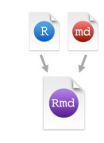

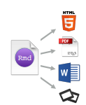
R Markdown Overview
.Rmd files An R Markdown (.Rmd) file is a record of your research. It contains the code that a scientist needs to reproduce your work along with the narration that a reader needs to understand your work
At the click of a button, or the type of a command, you can rerun the code in an R Markdown file to reproduce your work and export the results as a finished report.
You can choose to export the finished report as a html, pdf, MS Word, ODT, RTF, or markdown document; or as a html, pdf, or ppt based slide show.

Slide 6
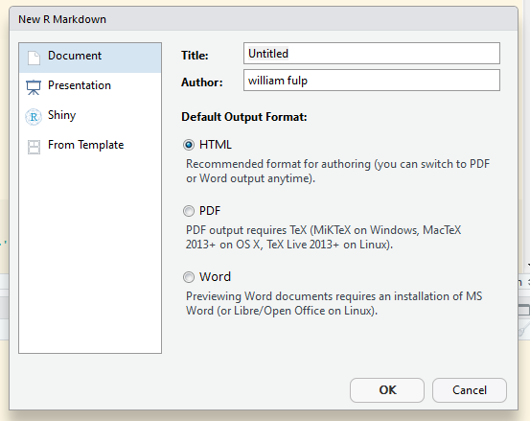
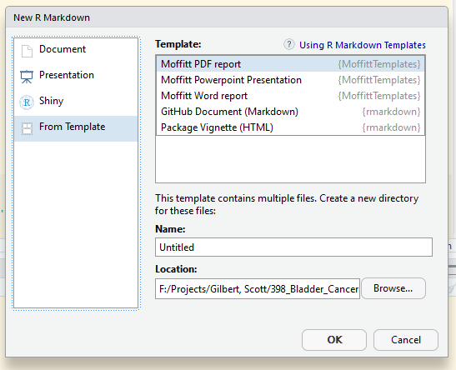
R Markdown Workflow (Step 1)
Open a new .RMD file at
File -> New File -> R Markdown
Use the wizard that opens to pre-populate the file with a template

Slide 7
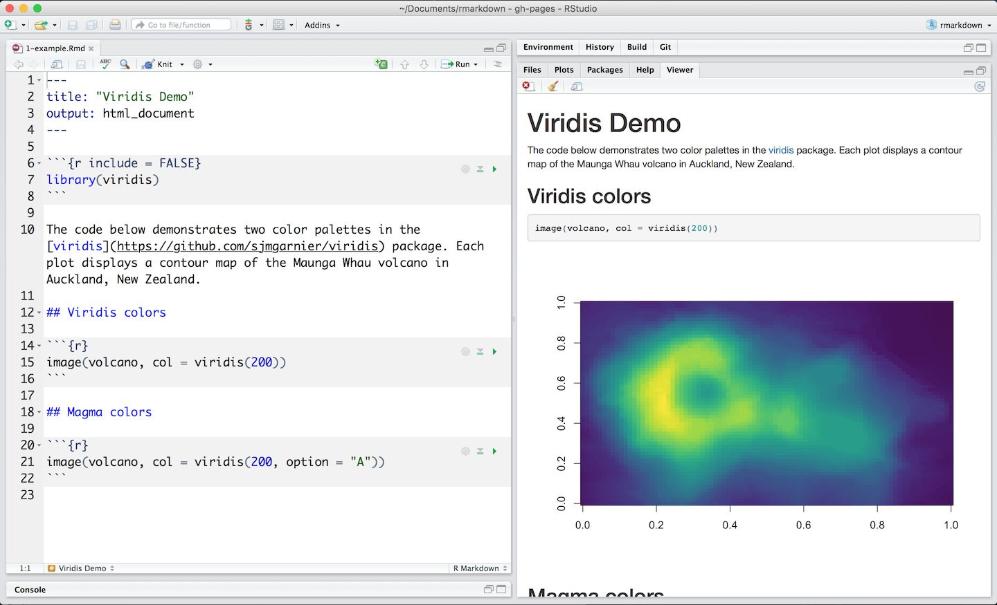
R Markdown Workflow (Step 2)
Write document by editing the template

Slide 8
R Markdown Workflow (Steps 3-6)
Knit document to create report
Use knit button or render() function to knit
Preview Output in RStudio
Examine build log in R Markdown console
Use output file
Time to Create Basic R Markdown Reports

Slide 9


R Code
R Code Chunks are where you write all your R code
Inline code can be sprinkled within text, to add a specific value
i.e. sample size or a specific statistic
Insert with `r <code>`
Code chunks
One or more lines surrounded with ```{r} and ```. Place chunk options within curly braces, after r. Insert with
You can insert an R code chunk either using the RStudio toolbar (the Insert button) or the keyboard shortcut Ctrl + Alt + I (Cmd + Option + I on macOS).

Slide 10
R Code Chunk Options
You have fine control over all output via chunk options, which can be provided inside the curly braces.
Some Popular chunk options:
echo: Display code in output document (default = TRUE)
eval: Run code in chunk (default = TRUE)
fig.cap: figure caption as character string
fig.height, fig.width: Dimensions of plots in inches
results (default = 'markup')
'asis' - passthrough results (if using kable or xtable)
'hide' - do not display results
'hold' - put all results below all code
warning - display code warnings in document (default = TRUE)
Can set global options with knitr::opts_chunk$set()
knitr::opts_chunk$set(echo = FALSE)

Slide 11
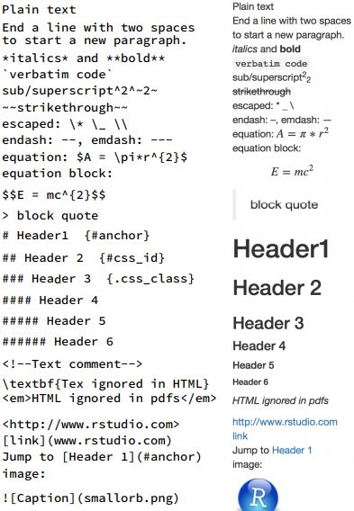
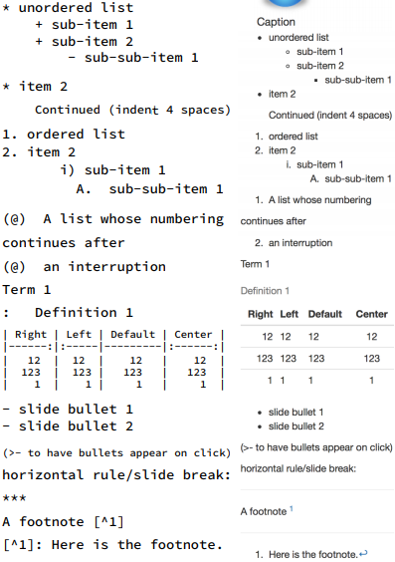
Markdown Basics

Slide 12
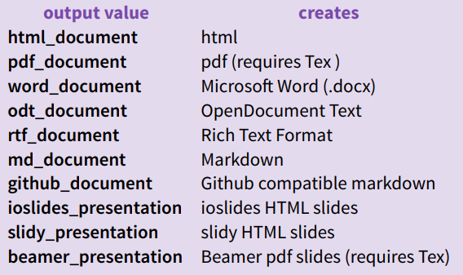
Render Options with YAML
Set title, author name(s), date, and other parameters that will appear in the report.
Set a documents output format in the YAML header
Add specific output options such as toc (show Table of Contents?)

Slide 13
Time to Modify Our Reports

Slide 14
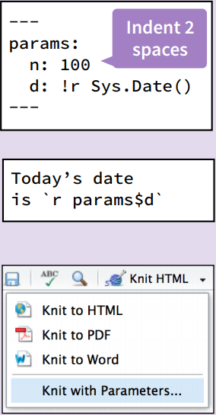
R Markdown with Parameters
Parameterize your documents to reuse with different inputs (e.g., data sets, values, etc.)
Add parameters
Create and set parameters in the header as sub-values of params
Call parameters
Call parameter values in code as params$<name>
Set parameters 3 Set values with Knit with parameters or the params argument of render()
render("doc.Rmd", params = list(n = 1, d = as.Date("2015-01-01"))

Slide 15
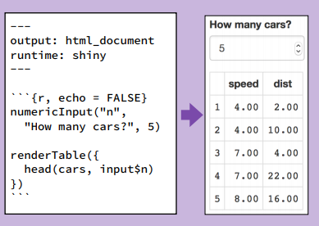
Interactive Documents (Shiny)
Add runtime: shiny to the YAML header.
Call Shiny input functions to embed input objects.
Call Shiny render functions to embed reactive output.
Render with rmarkdown::run or click Run Document in RStudio IDE

Slide 16
Learning More About R Markdown
RStudio Cheat Sheet:
https://www.rstudio.com/wp-content/uploads/2016/03/rmarkdown-cheatsheet-2.0.pdf
R Markdown: The Definitive Guide
Yihui Xie, J. J. Allaire, Garrett Grolemund
https://bookdown.org/yihui/rmarkdown/

Slide 17
Custom Moffitt Templates (MoffittTemplates R package)
Can create custom templates for repetitive types of reports
Also useful for fancy reports (i.e. adding the Moffitt logo)
Currently there are templates written for pdf, word, and ppt (exploratory) outputs
pdf and word templates go through a basic analysis
Code for doing descriptive tables, logistic and cox modeling, boxplots and KM curves
remotes::install_github("wfulp/MoffittTemplates")
If Templates not populating probably a Moffitt drive path issue
set environment variable R_LIBS_USER to the value of the file path to your desired library folder

Slide 18
Custom Moffitt Functions (MoffittFunctions R package)
MoffittFunctions is an R package with functions designed to assist statisticians getting from an analytical dataset to a professional looking report.
Can be grouped into these sections:
Testing Functions
Fancy Output Functions
Utility Functions
Example Dataset
Package is heavily used by MoffittTemplates, which allows for much cleaner report code.
remotes::install_github("wfulp/MoffittFunctions")

Slide 19
Programs Needed for Reproducible Reports
R (Get newest version)
http://archive.linux.duke.edu/cran/
R Packages needed for most reports: rmarkdown, knitr, bookdown, tidyverse, kableExtra, devtools, remotes
MoffittFunctions and MoffittTemplates packages from GitHub
remotes::install_github("wfulp/MoffittFunctions")
remotes::install_github("wfulp/MoffittTemplates")
Update all R packages (RStudio -> Packages tab -> Update button)
RStudio (Get newest version)
https://www.rstudio.com/products/rstudio/download
Pandoc for Word, html, and PowerPoint reports
Comes with RStudio, but need a newer version needed for ppt reports(>=2.0.0)
https://pandoc.org/installing.html
Or use installr package in R to download through R
installr::install.pandoc()
tinytex for pdf reports
install.packages('tinytex')
tinytex::install_tinytex()
If you already have MikTex installed no need to install tinytex

Slide 20
Stride Messaging
We have a Stride Group called bio2-moffitt
Email me and I’ll send you an invite
Relevant Rooms for R Markdown discussion
R
Moffitt Functions/Macros
Reproducible Research
Better to ask questions here than 1-on-1, in case other people have similar questions

Slide 21
Time to Try the Templates

